Slide 1
Semester Project of CYBR8480
Chat App
Presenter: Zidong
Instructor: Dr. Hale

Slide 2
Project Summary
In today's world, science and technology are growing, and more and more APPs appear on our mobile phones. For example, there are many shopping apps, restaurant apps, travel apps and so on on my mobile phone.
I wondered, what app do I need in my phone?
Make friends!!!

Slide 3
Project Goals
User authentication : We will provide an application user chat interface to allow our users to interact with other users.
ID card : Provide basic personal information so that everyone can understand your basic information from the very beginning.
Dice game : This feature is very interesting!
Map : This system provides chat real-time positioning function.
Music: You can open this App and show your talents to your friends.
Chat : Chat system has always provided users with a timely and secure chat system, connected via Google database。

Slide 4
User case analysis
User stories
As a freshman, especially at the beginning of school, in this new environment, I want to meet some new people by chatting and making friends to enrich my spare time, so that I can make my life Full of enthusiasm and passion.
As a person with a talent for music, I want to show my talents when I get along with my friends, so that I can show my talents anytime and anywhere, so that the other person can appreciate myself.
As a person who likes to communicate with each other face to face, I want to know how far the two people are, and know my current location at any time, so that I don’t get lost and miss the opportunity to meet each other.

Slide 5
User case analysis
Misuser stories
As a cyber thief who wants to know personal information, I want to use some external tools to sniff users' personal information from chat applications, so that these users' information can be used to locate, blackmail or threaten them.
As an Internet hacker in social engineering, I want to collect user location information from chat applications in order to sell this information to stakeholders.

Slide 6
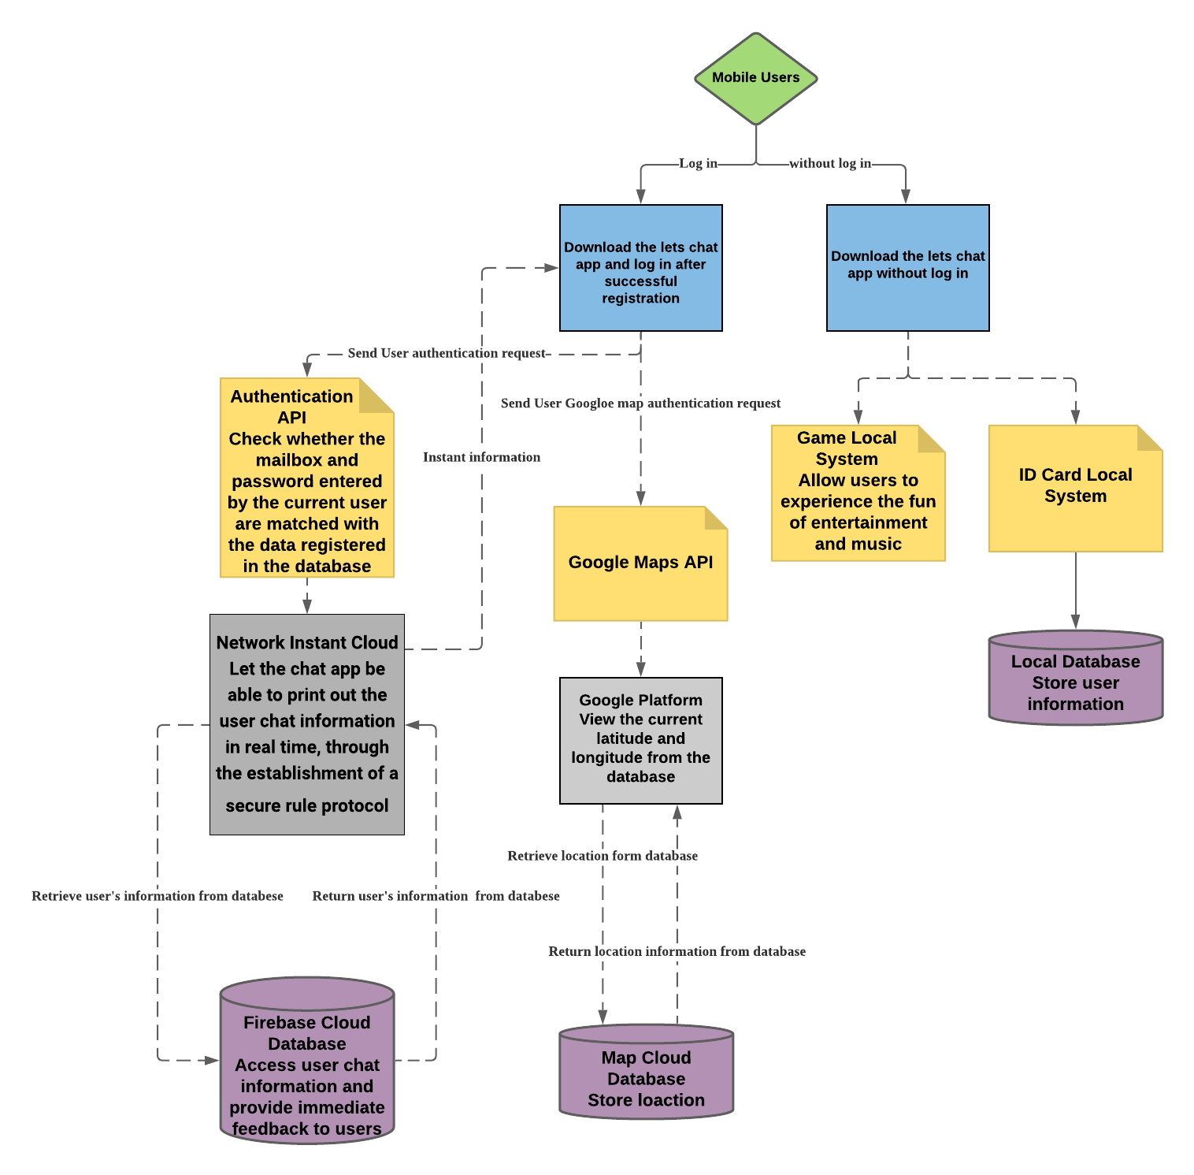
App Design

Slide 7
Component List
Authentication Component
User Login
User Register
Google Map Service Component
GPS Service
Two-person Distance
Local Entertainment Features Service
Sieve Mode
Music Mode
Chat system Service
Grop chat

Slide 8
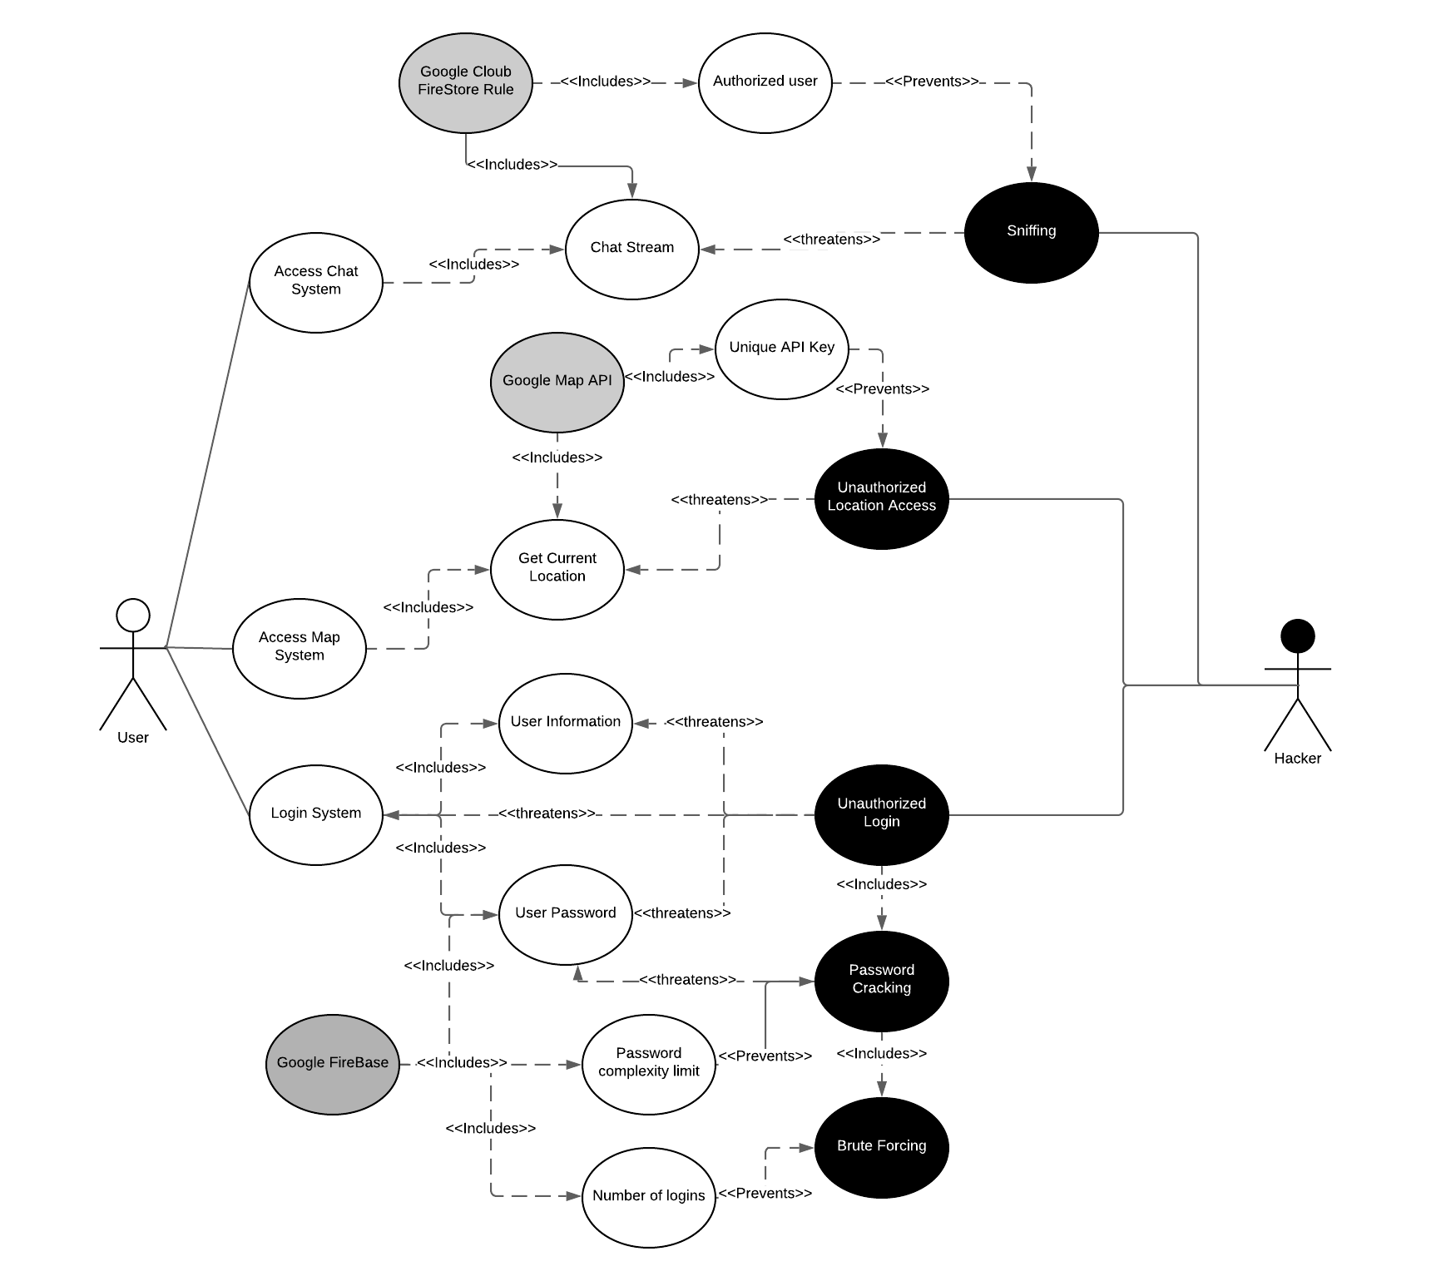
Security analysis

Slide 9
Implementation Video
Please visit the demo along this presentation at this link: https://app.vidgrid.com/view/tSy0JJZw5J3w

Slide 10
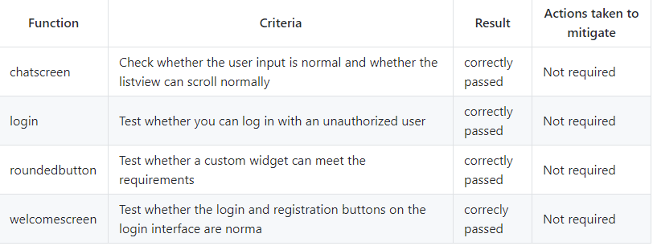
Testing

Slide 11
More Development
If possible, my idea is to be able to directly stack the ID card information through two mobile phones and directly join the chat system.
Realize multi-person GPS location sharing and display.
Join real-time game interaction and set leaderboards

Slide 12
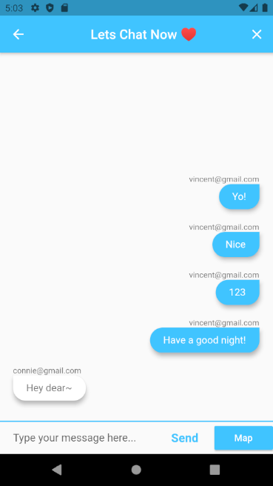
Demo

